Slide 1
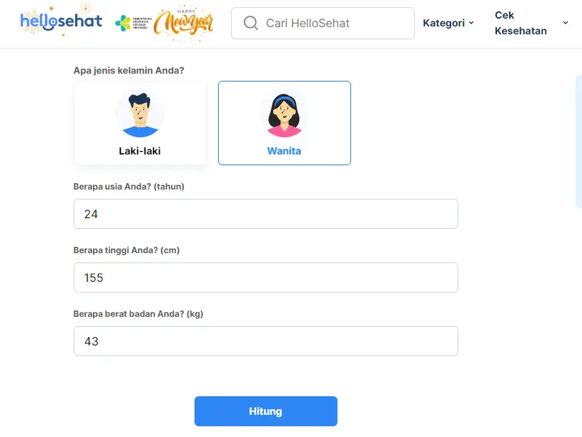
Ideal-D Predict

Slide 2
Ideal-D Profiler

Slide 3
Ideal-D Progress

Slide 4
Ideal-D Insights

Slide 5
Ideal-D Edu

